Slide 1
Radio Systems
Pellissippi State
Applied Systems Development
Spring 2017

Slide 2
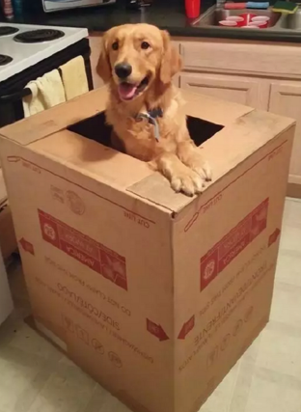
David:
Data Process Engineer

Slide 3
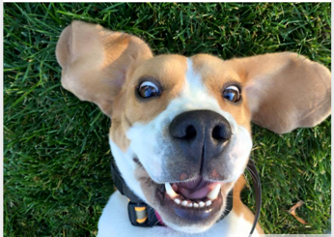
Randy:
Signature, Email & C# Guru

Slide 4
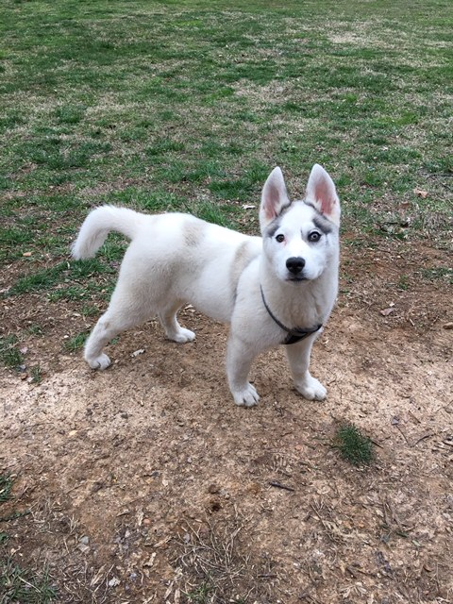
Aaron:
Graphics Designer & Documenter

Slide 5
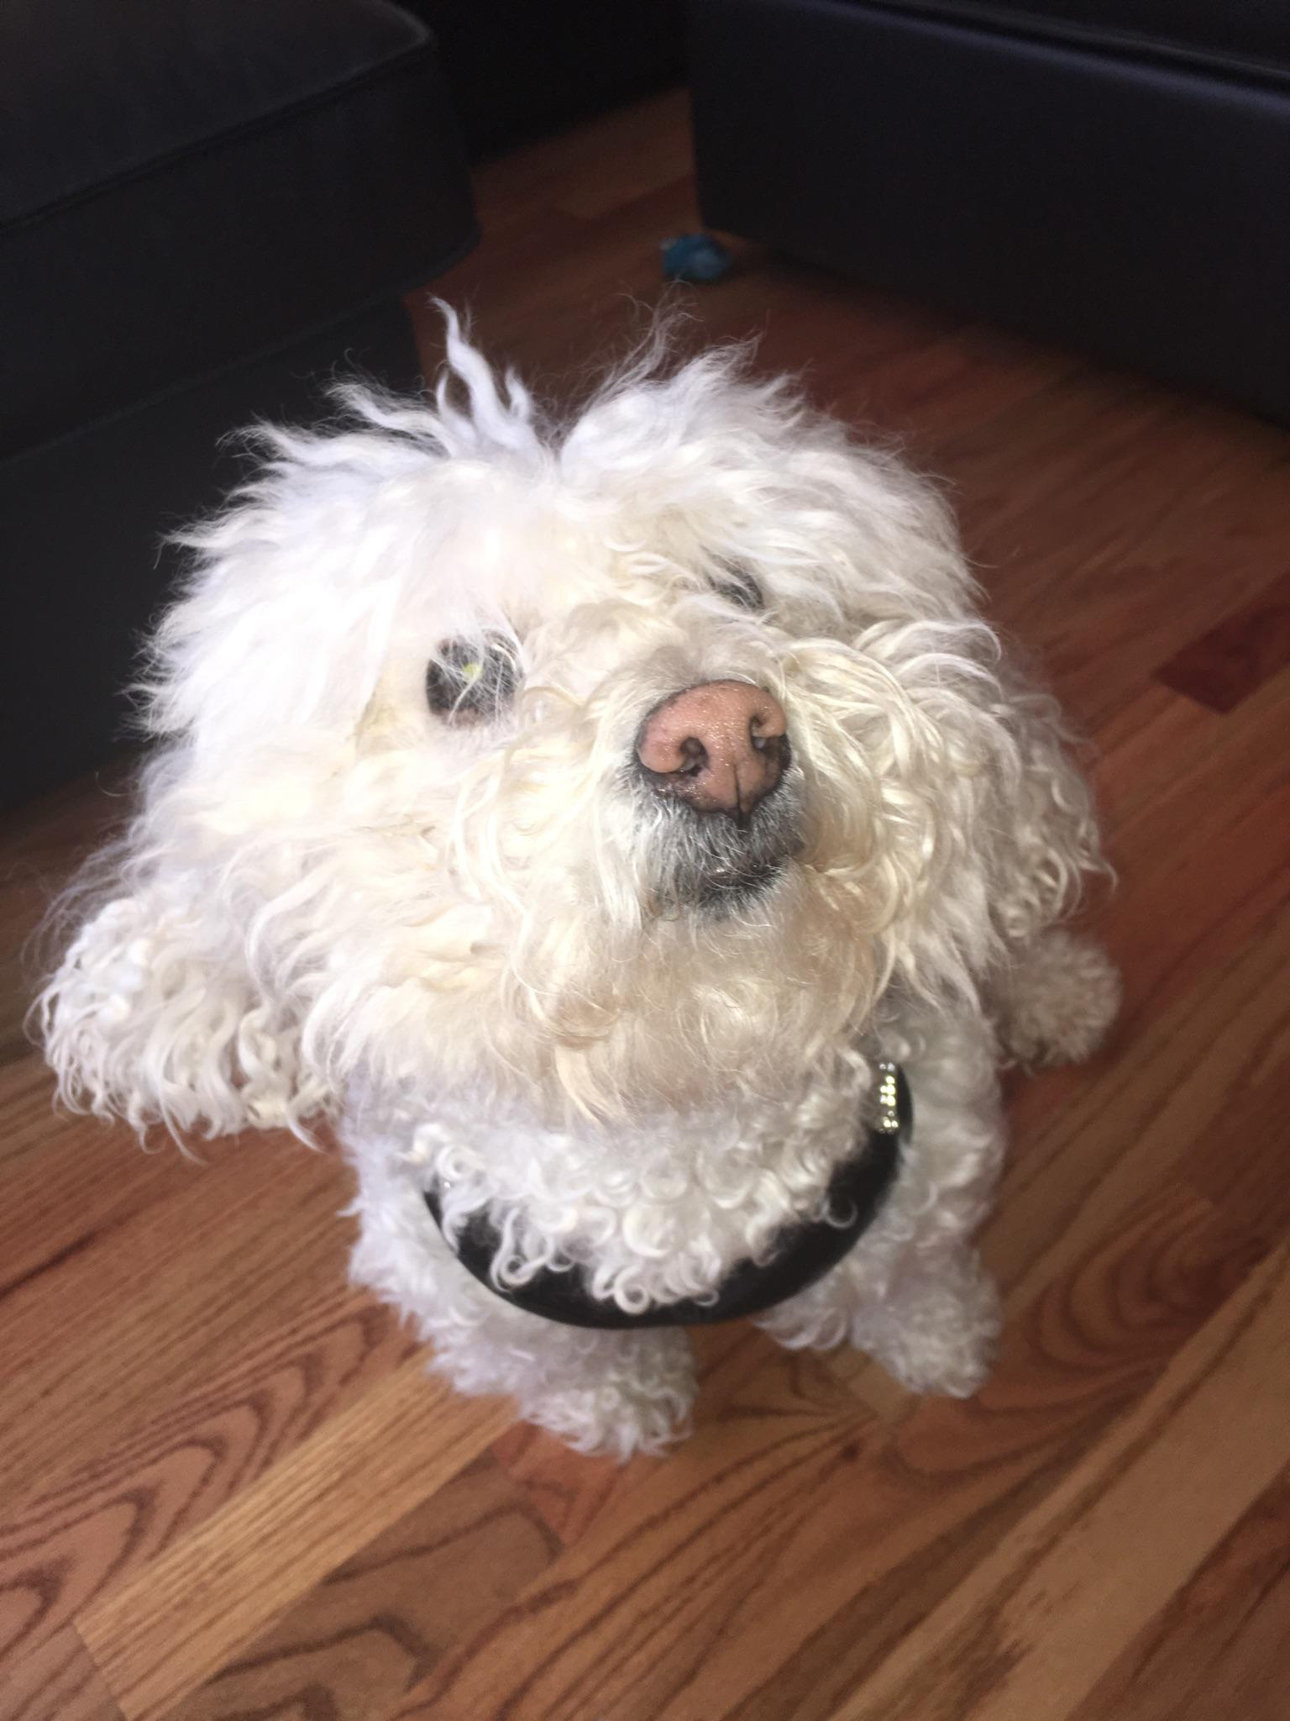
Michelle:
Graphic Designer &
Content Reviewer

Slide 6
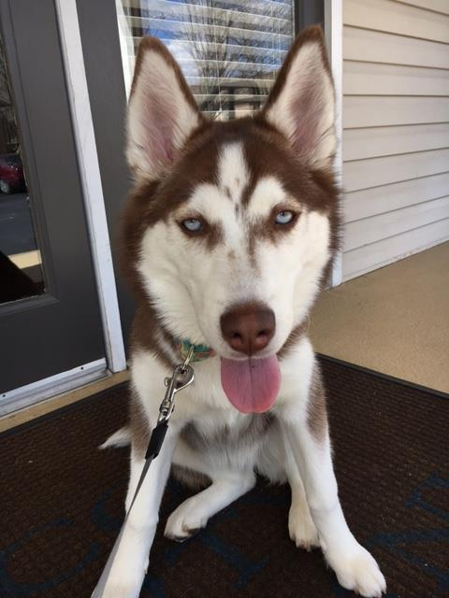
Donna:
Project Management &
Window Design

Slide 7
Introduction & Process
Michelle

Slide 8
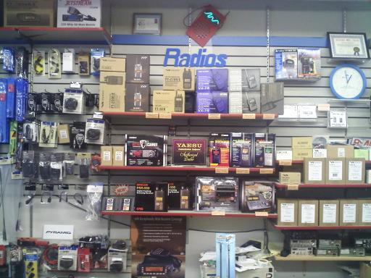
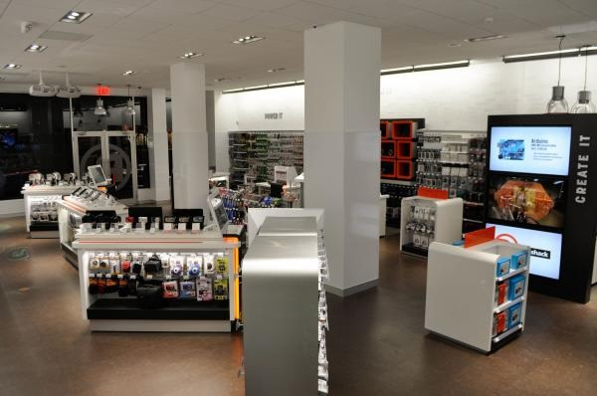
Radio Systems??

Slide 9

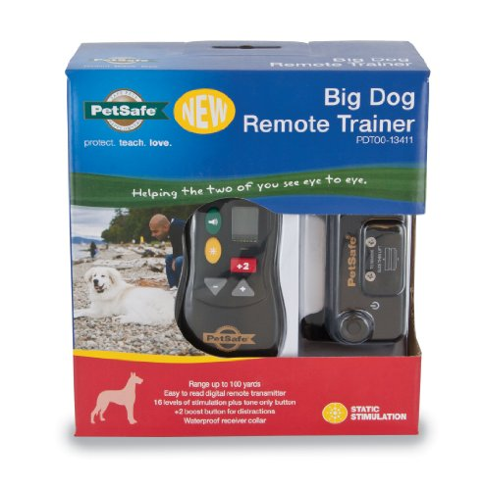



Slide 10
Company Facts: Locations:
Founded in 1991
Headquarters in Knoxville, TN
Initial IPO on Nasdaq in 1997
Now a Privately-Owned Multinational Corporation
Markets pet behavioral, containment, and lifestyle product solutions.
Last year, Radio Systems contributed more than $3,500,000 in volunteer support, grants, and product donations to organizations working to improve animal welfare or youth education.
Knoxville, Tennessee
Glen Allen, Virginia
Durham, North Carolina
Dundalk, Ireland
Chorley, United Kingdom
Shenzhen, China
Gold Coast, Australia

Slide 11
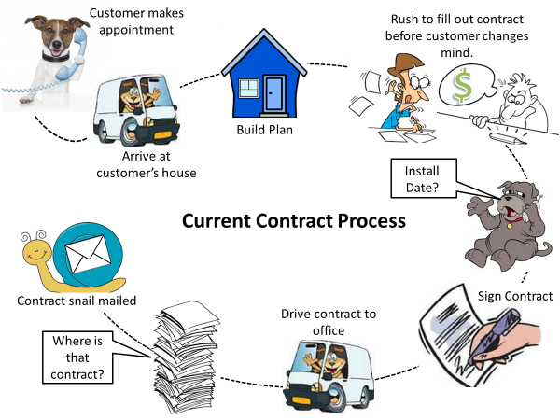

Slide 12
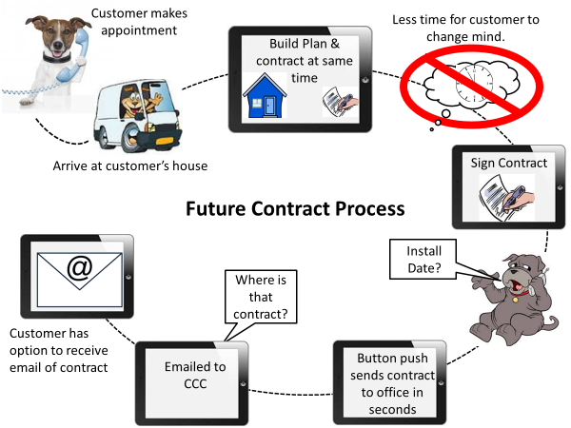

Slide 13
Technology
And the Challenges We’ve Faced….So Far!
Donna

Slide 14
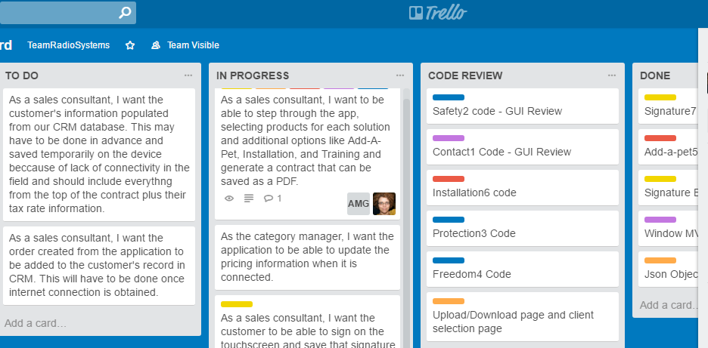
Trello: Project Management

Slide 15
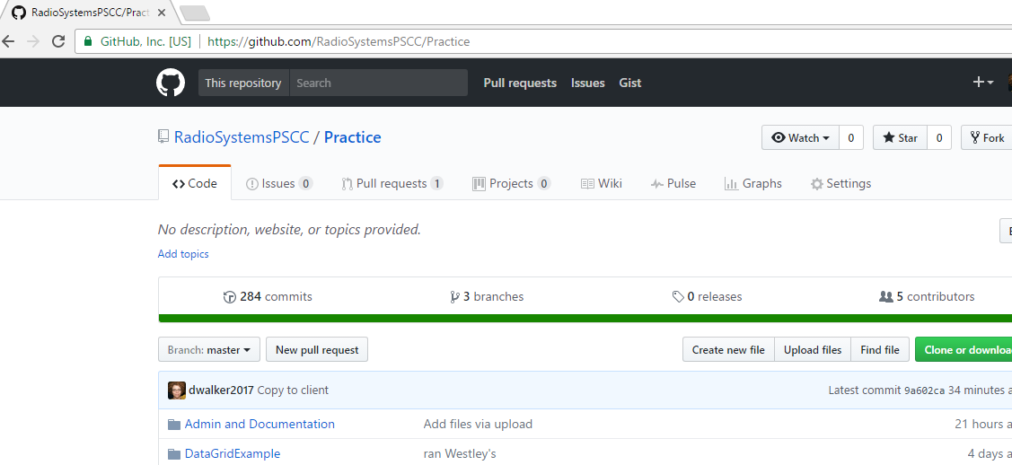
Version Control: Git & GitHub

Slide 16
What We’re Learning:
Data Binding
XAML
WPF
Web Service API
MVVM
Json

Slide 17
Challenges Faced:
Grid Styling in XAML
Sharing a GitHub project with binary debugger files
Signature & PDF methodology
Hamburger Menu
Custom Window
Data Context Navigation
Getting Json data into a datagrid
MVVM
Relative Addressing of Json files

Slide 18

Architecture: MVVM
Dependencies
Commands
Bindings
Triggers
Data Templates
Data Context
INotifyPropertyChanged

Slide 19
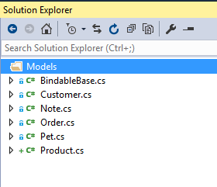
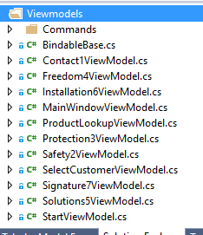
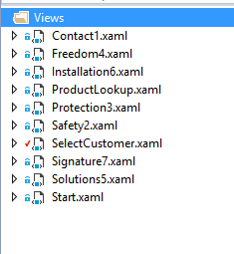
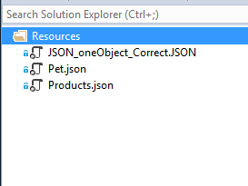
Model
ViewModel
View
Json

Slide 20
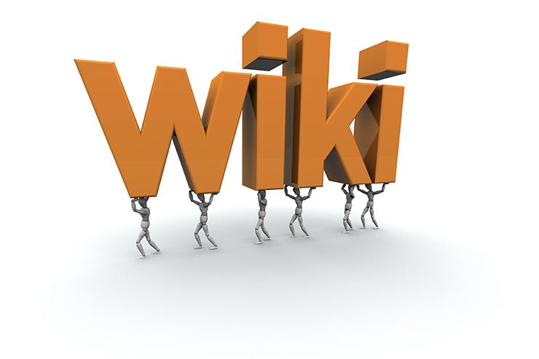
Wiki Walkthrough
Aaron

Slide 21
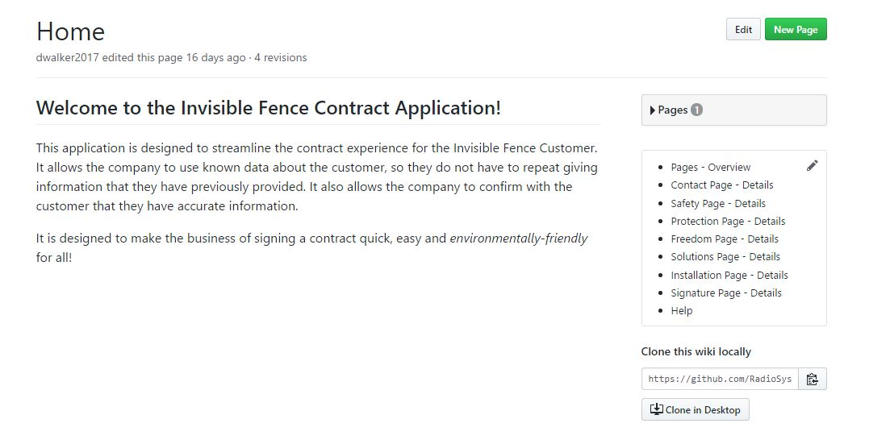
GitHub Wiki Home

Slide 22
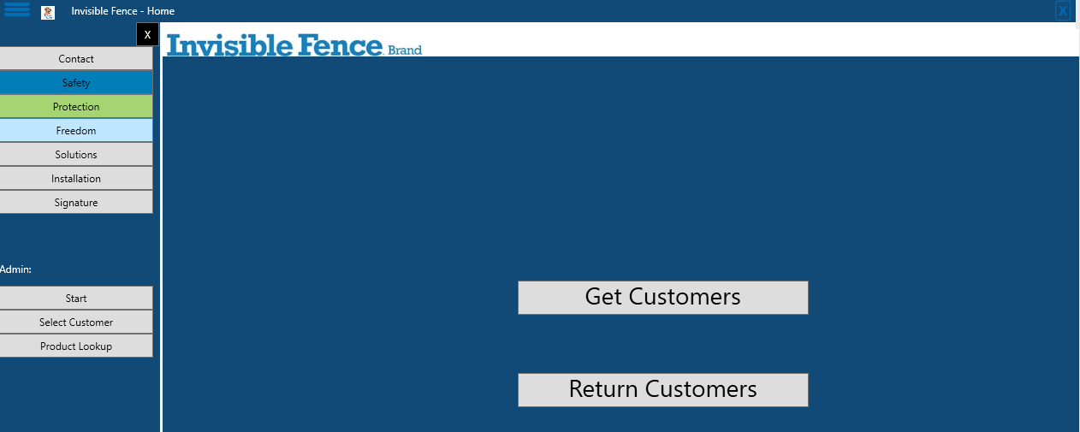
StartUp Page

Slide 23
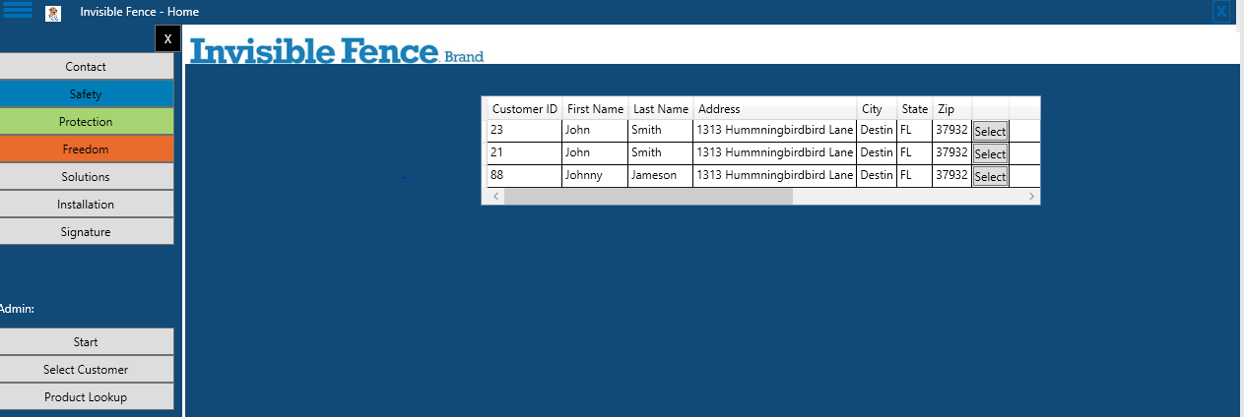
Select Customer

Slide 24
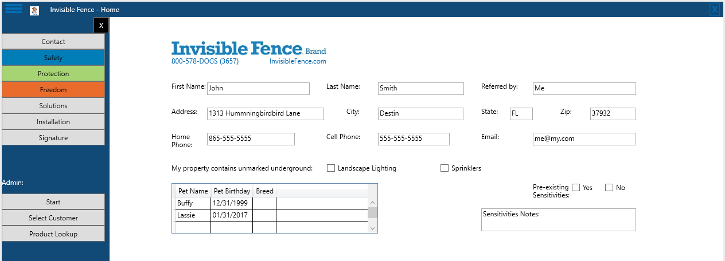
Contact

Slide 25
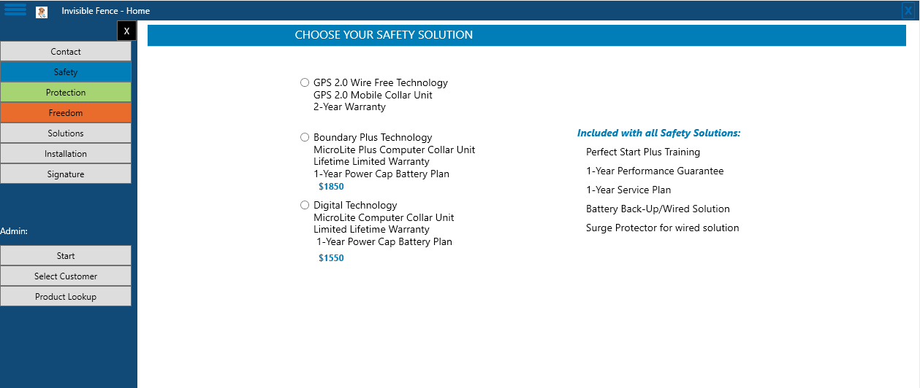
Safety

Slide 26
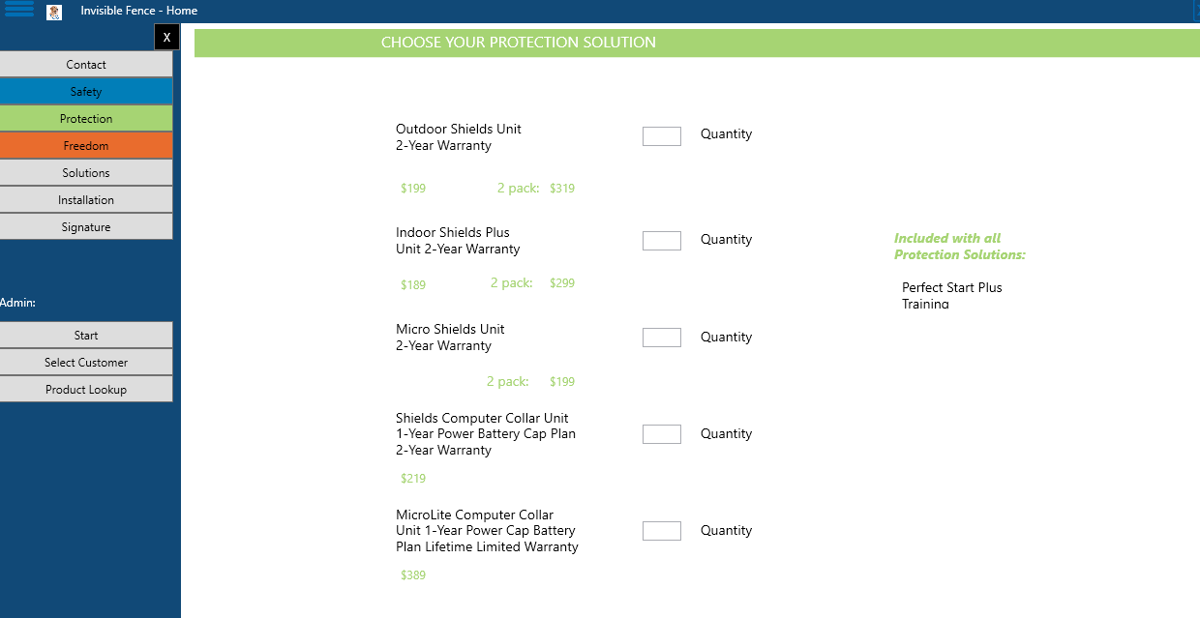
Protection

Slide 27
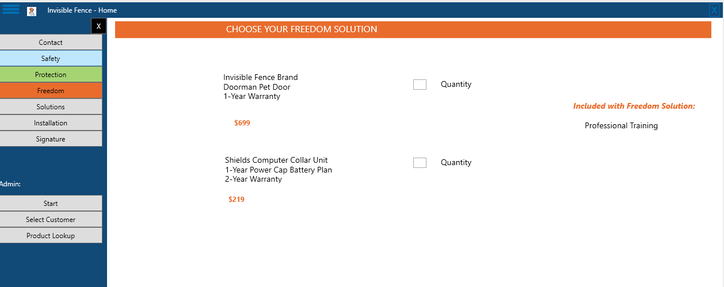
Freedom

Slide 28
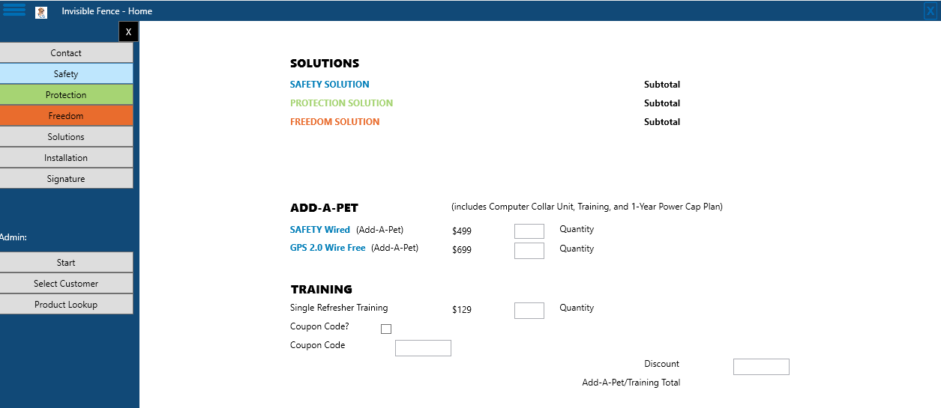
Solutions

Slide 29
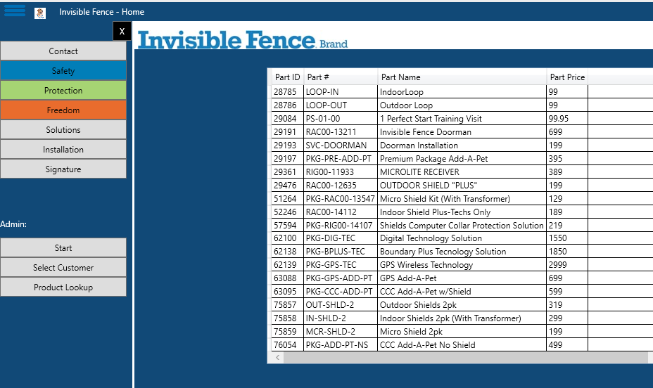
Part Lookup Page

Slide 30
Signatures, PDFs & Emails
Randy

Slide 31
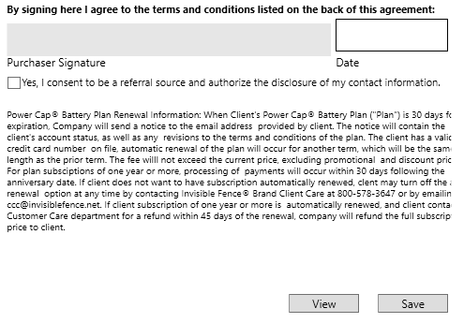
Signature

Slide 32
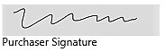
InkCanvas
WPF control/class that is used to capture ink strokes.
Input is stored as Stroke objects.
These objects will be stored with the rest of the client information.
Stroke objects will then be inserted into the PDF along with the rest of the client information.

Slide 33
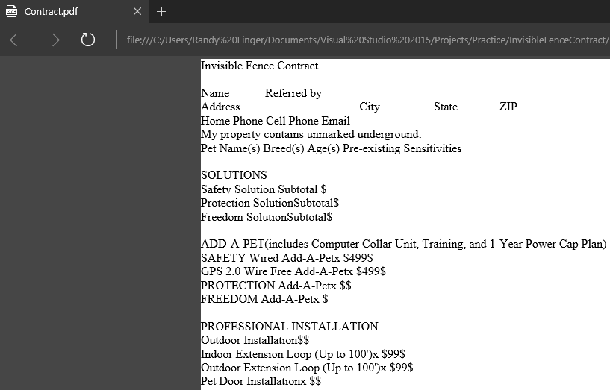
PDFsharp
PDFsharp is a .NET library that is used to create pdf files and allows you to control every line of text that is drawn.
PDFsharp version 1.32 is being used to create contract PDF.
PDFsharp has the ability to create pdf documents from text or image data.
Two possible approaches for application:
1. Create pdf using text data. Format the text to resemble contract.
2. Create view and populate with data. Create pdf from view image.
Current approach: Text data
PDFsharp allows different fonts, font sizes, font color, etc.

Slide 34
SendGrid
SendGrid is a cloud-based SMTP(Simple Mail Transfer Protocol) provider.
Client preference for sending email
Two ways to send email:
1. SMTP relay
2. Web API
Current approach: Web API
Client wants contract to be emailed to Radio Systems customer care center and to the client.

Slide 35



Data
By David

Slide 36




Data Flow

Slide 37
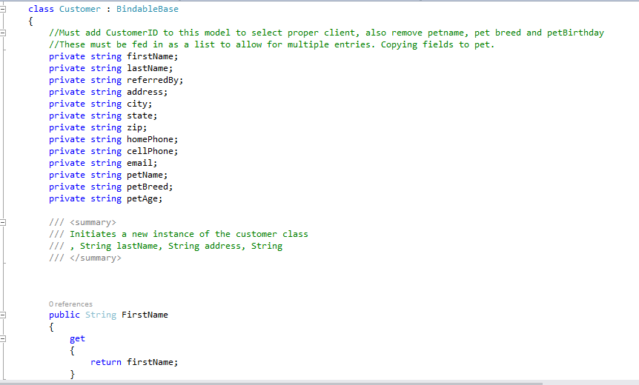
Model

Slide 38
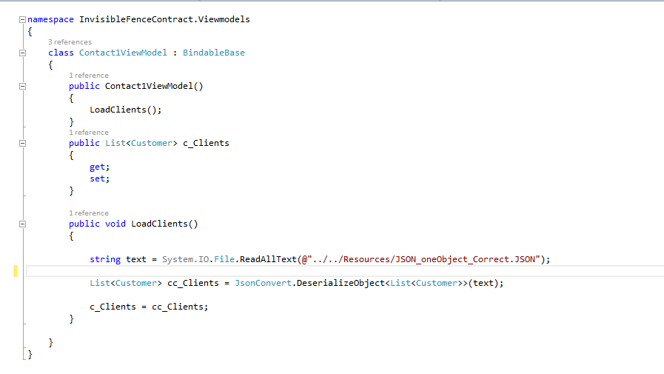
ViewModel

Slide 39
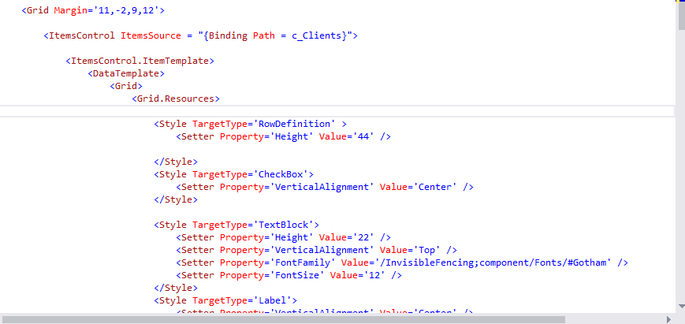
View

Slide 40
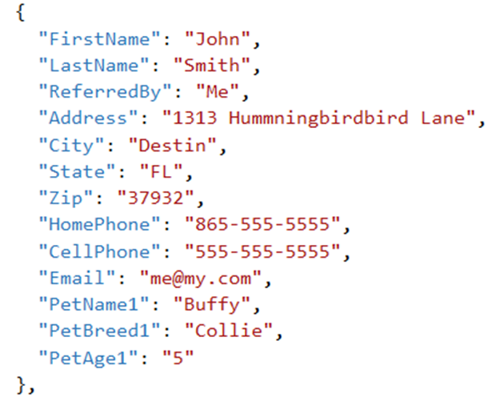
Incoming File

Slide 41
Output
{
"FirstName": "John",
"LastName": "Smith",
"ReferredBy": "Me",
"Address": "1313 Hummningbirdbird Lane",
"City": "Destin",
"State": "FL",
"Zip": "37932",
"HomePhone": "865-555-5555",
"CellPhone": "555-555-5555",
"Email": "me@my.com",
"PetName1": "Lassie",
"PetBreed1": "Collie",
"PetAge1": "5"
},

Slide 42
Construction Completion Date: 4/26/17

Slide 43
?
?
Questions
?
?
?
?
?

Slide 44



No pets were harmed in the making of this presentation…

